Slide 1
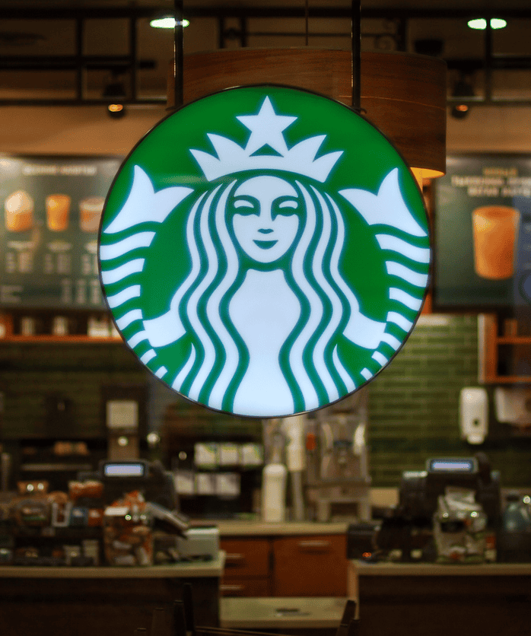
How Starbucks Could Increase Engagement
Robert Luby

Slide 2
Set-Up Part 1
This analysis will determine if ads can drive high levels of engagement for Starbucks by increasing their conversion rate and decreasing their cost per conversion.
Hypothesis: By effectively increasing the conversion rate and efficiently decreasing the cost per conversion, the brand can drive high levels of engagement.
The dataset pertains to the preceding factors:
  Store ID/Store Number;
  Phone Number, Full Address, City, County, Zip Code, State, Designated Market Area;
  Regular Hours, Saturday/Sunday Opening Times, 24-hour availability;
  Drive thru availability, free Wi-Fi, the type of media support received, the amount spent; and
  The number of impressions, clicks, conversions, and post engagements.

Slide 3
Set-Up Part 2
The dataset was generated in the last 90 days of the first quarter of 2021.
It is located in Excel.

Slide 4

Executive Summary
Starbucks has more clicks, impressions, spending, and post engagements than conversions.
Advertising could increase revenue, conversions, engagement, the number of store visits, the amount of time spent in the stores, and could lower the cost per conversion.

Slide 5
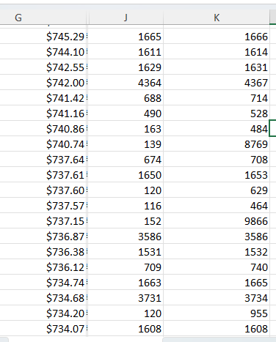
Business Implications
If ads increase engagement and boost overall revenue, the company could increase conversions, reduce cost-per-conversion, and maximize engagement.

Slide 6
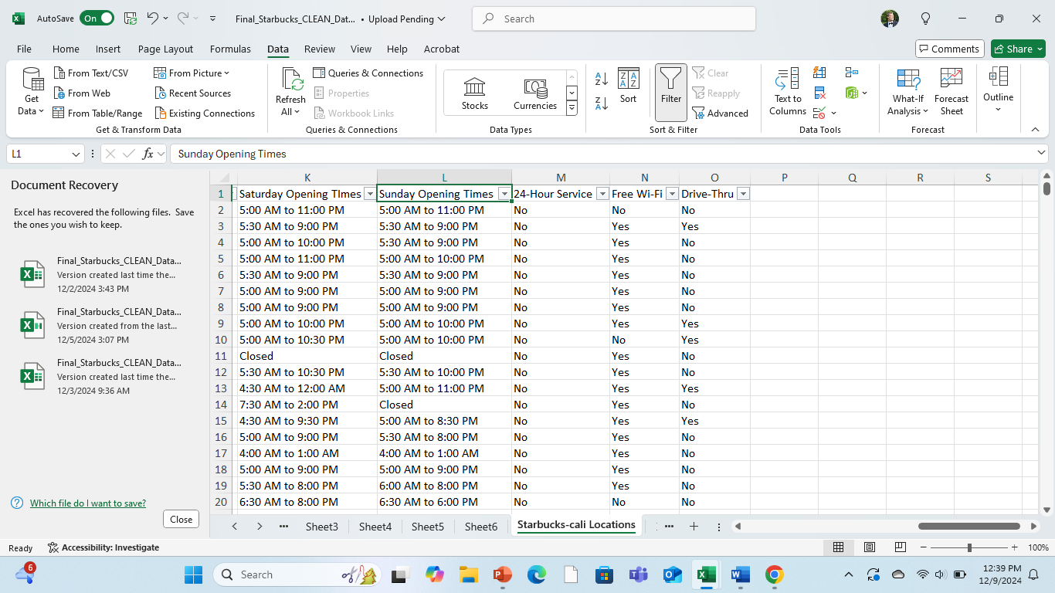
Business Implications Part Two
Stores that close before 10:00 pm have less potential for advertising to increase conversions, increase engagement, and decrease the cost per conversion.
Expanding store hours would allow the company to easily increase its conversions.

Slide 7
Business Implications Final Part
Lack of 24-hour service or free Wi-Fi also limits the potential for ads to increase engagement, lower cost per conversion, and boost overall conversions.

Slide 8
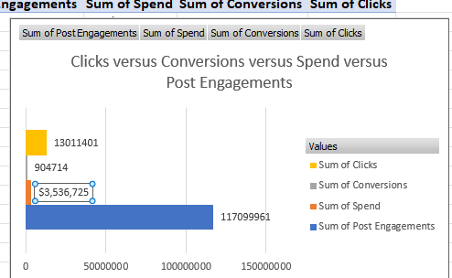
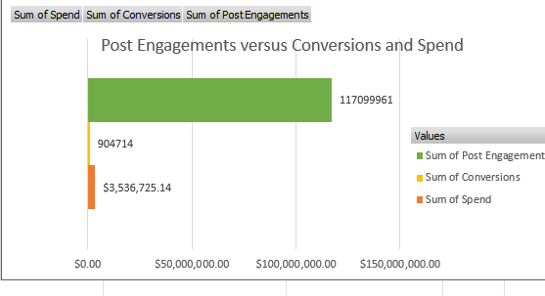
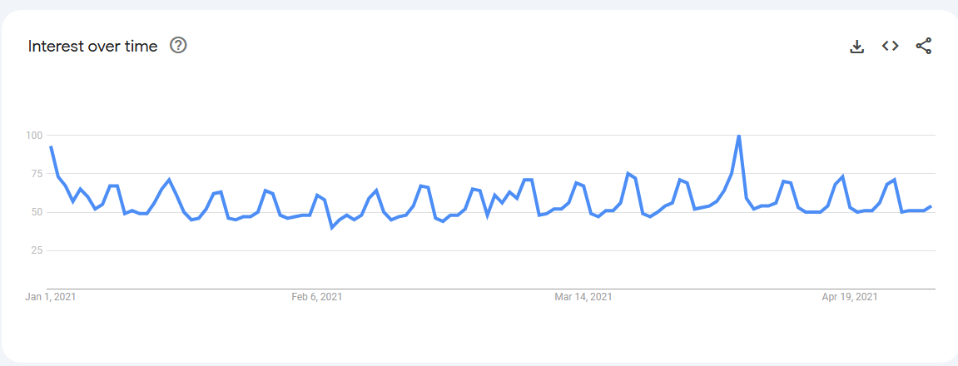
Supporting Evidence

Slide 9
The End

